Slide 1
Activation Function

Slide 2
Activation
Function
Activation Function

Slide 3
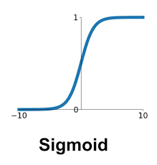
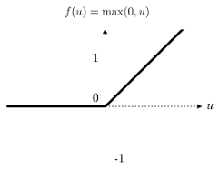
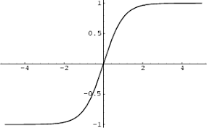
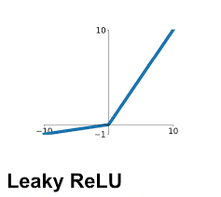
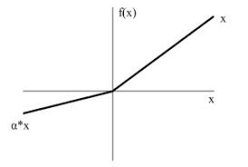
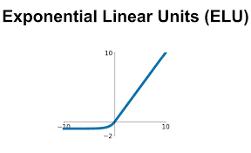
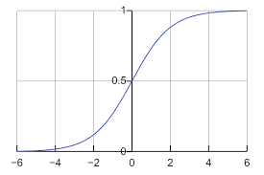
Activation
Function
What is the difference?
Hyperbolic Tangent
ReLU
PReLU
SoftSign

Slide 4
Activation
Function
Symmetry
ReLU

Slide 5
Activation
Function
Pros and Cons?
ReLU

Slide 6
Pros
Cons
Sigmoid
Pros : Symmetry
Cons : Gradient Vanishing

Slide 7
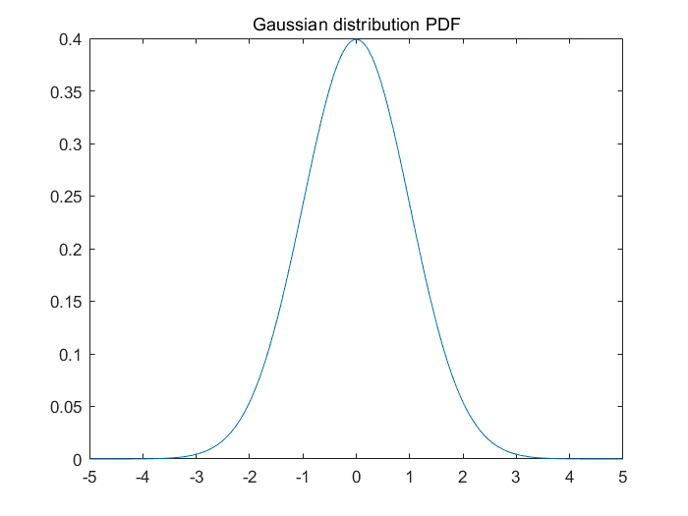
Pros
Cons
Why is Symmetry an advantage?
The Gaussian Distribution

Slide 8
Pros
Cons
Why is gradient vanishing a disadvantage?

Slide 9
Pros
Cons
ReLU
Pros : Fast Caculation, reduce GV
Cons : Baised, Dying ReLU

Slide 10
Pros
Cons
ReLU
ReLU Gradient :

Slide 11
Pros
Cons
ReLU
Baised

Slide 12
Pros
Cons
We can think of two things
Frist, biased
Second, gradient Vanishing
How do you solve it?

Slide 13
Pros
Cons
We can think of two things
Frist, biased
Second, gradient Vanishing
How do you solve it?

Slide 14
감사합니다
THANK YOU

